Slide 1
About The Royal Canadian Legion
Legion.ca
2024-05-03
©THE ROYAL CANADIAN LEGION
Notes:
Thank you for coming!
I’m pleased to be here to speak to you about The Royal Canadian Legion.
I’ll give you a snapshot of our history, what we do, and where we’re going.
At the end (or during my presentation) I’d be happy to take any questions.

Slide 2
OVERVIEW
The Royal Canadian Legion
Our mission is to serve Veterans, including still serving military and RCMP members and their families, to promote Remembrance, and to serve our communities and our country.
Notes:
The Royal Canadian Legion’s mission is to serve Veterans and their families – including still serving and retired military, RCMP members and their families. We also promote Remembrance, and serve our communities and country.
These badges represent the Canadian Armed Forces, the RCMP, and The Royal Canadian Legion.
We are Canada’s largest Veteran support organization.
I’ll get into examples of The Legion’s work in just a bit.

Slide 3
OVERVIEW
Who we are
Dominion Command
National Headquarters – Ottawa
10 Provincial Commands
All provinces and territories
Some combined regions
British Columbia & Yukon
Alberta & Northwest Territories
Manitoba & Northwestern Ontario
Nova Scotia & Nunavut
1,350 branches 260,000 members
Thousands of Volunteers
Notes:
Our national headquarters are in Ottawa.
We have ten provincial Commands, which include all provinces and territories. Some of our regions are combined as you see here.
Across the country there are 1,350 branches and close to 260,000 members and that includes thousands of volunteers. They’re the ones who help us with everything from our yearly Poppy Campaign to our local Branch events.
Although we have national headquarters and provincial-territorial Commands, and we’re all connected, each level operates autonomously. We also operate independently from government and receive no government funding under normal circumstances. (Our Branches did receive substantial federal funding -14 million total - for the first time ever, during the COVID-19 pandemic.)
We operate according to the Legion’s General By-Laws and there are also Provincial and Branch By-Laws to govern regional operations.
We hold regular meetings at the Branch, Regional, and National level – our large Dominion Convention is held every two years. The next one is/was in August 2024 in St. John, New Brunswick. At these meetings, we review operations and members can put forward and vote upon resolutions if they are proposing some sort of change.

Slide 4
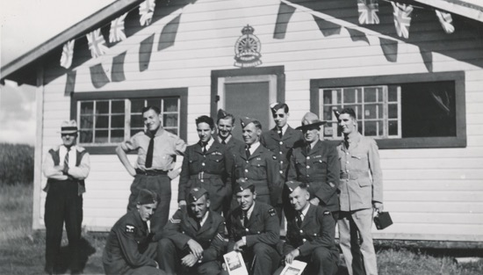
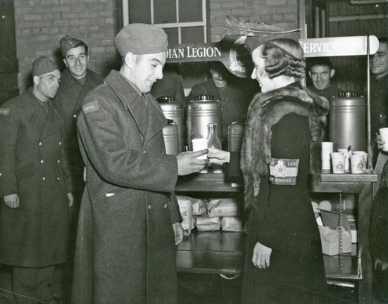
OVERVIEW
Our history
Winnipeg 1925
“The Canadian Legion of the British Empire Services League” Letter Patent (Charter) created in 1926
Ottawa 1948
Act of Parliament incorporates Legion
London 1960
Queen Elizabeth II consents to the use of prefix “Royal” – name becomes The Royal Canadian Legion
Ottawa 1961
Act of Incorporation amended to make change official
Notes:
I’d like to share a bit of history…and we have a long one! We celebrated 100 years of the Poppy symbol in 2021.
The Legion was born as The Canadian Legion of the British Empire Services League in Winnipeg in 1925. Veterans Groups in Canada decided to come together to speak with a common voice especially in dealing with governments.
By 1926, a Charter was created and in 1948 an Act of Parliament incorporated the Legion.
The first Dominion Convention was in Winnipeg in 1927!
These black and white photos show some of the Legion’s early activities – the top photo is of soldiers in front of a branch (Clear Lake but we’re not 100% sure which province – AB or BC)….below, is the Ladies Committee Convenor sharing a hot drink with soldiers.
Over the years, the Legion expanded to provide a way for returning soldiers to reunite and receive support.
We became the Royal Canadian Legion after Queen Elizabeth II consented to the prefix in 1960.
The official change was made in 1961 and that has been our name ever since.
Our identity is tied to our original badge which you saw at the beginning of the presentation, and with our fresh modern logo which you see here at the bottom corner of the presentation.
We also maintain an official dress code for formal events, which includes navy blazers, grey pants and accessories such as gloves, berets and medals as appropriate. Our Ladies’ Auxiliary has a complementary dress code as well.

Slide 5
OVERVIEW
Our 100th Anniversary!
The Legion will celebrate its centennial in 2026
Various events planned at a national level and across the country
Commemorative souvenir items in development
This Photo by Unknown Author is licensed under CC BY-SA
Notes:
As you have seen, the Legion has been around for a very long time… almost a century.
In 2026 we will officially celebrate our 100th anniversary
Planning is already underway for various events and commemorative souvenir items

Slide 6
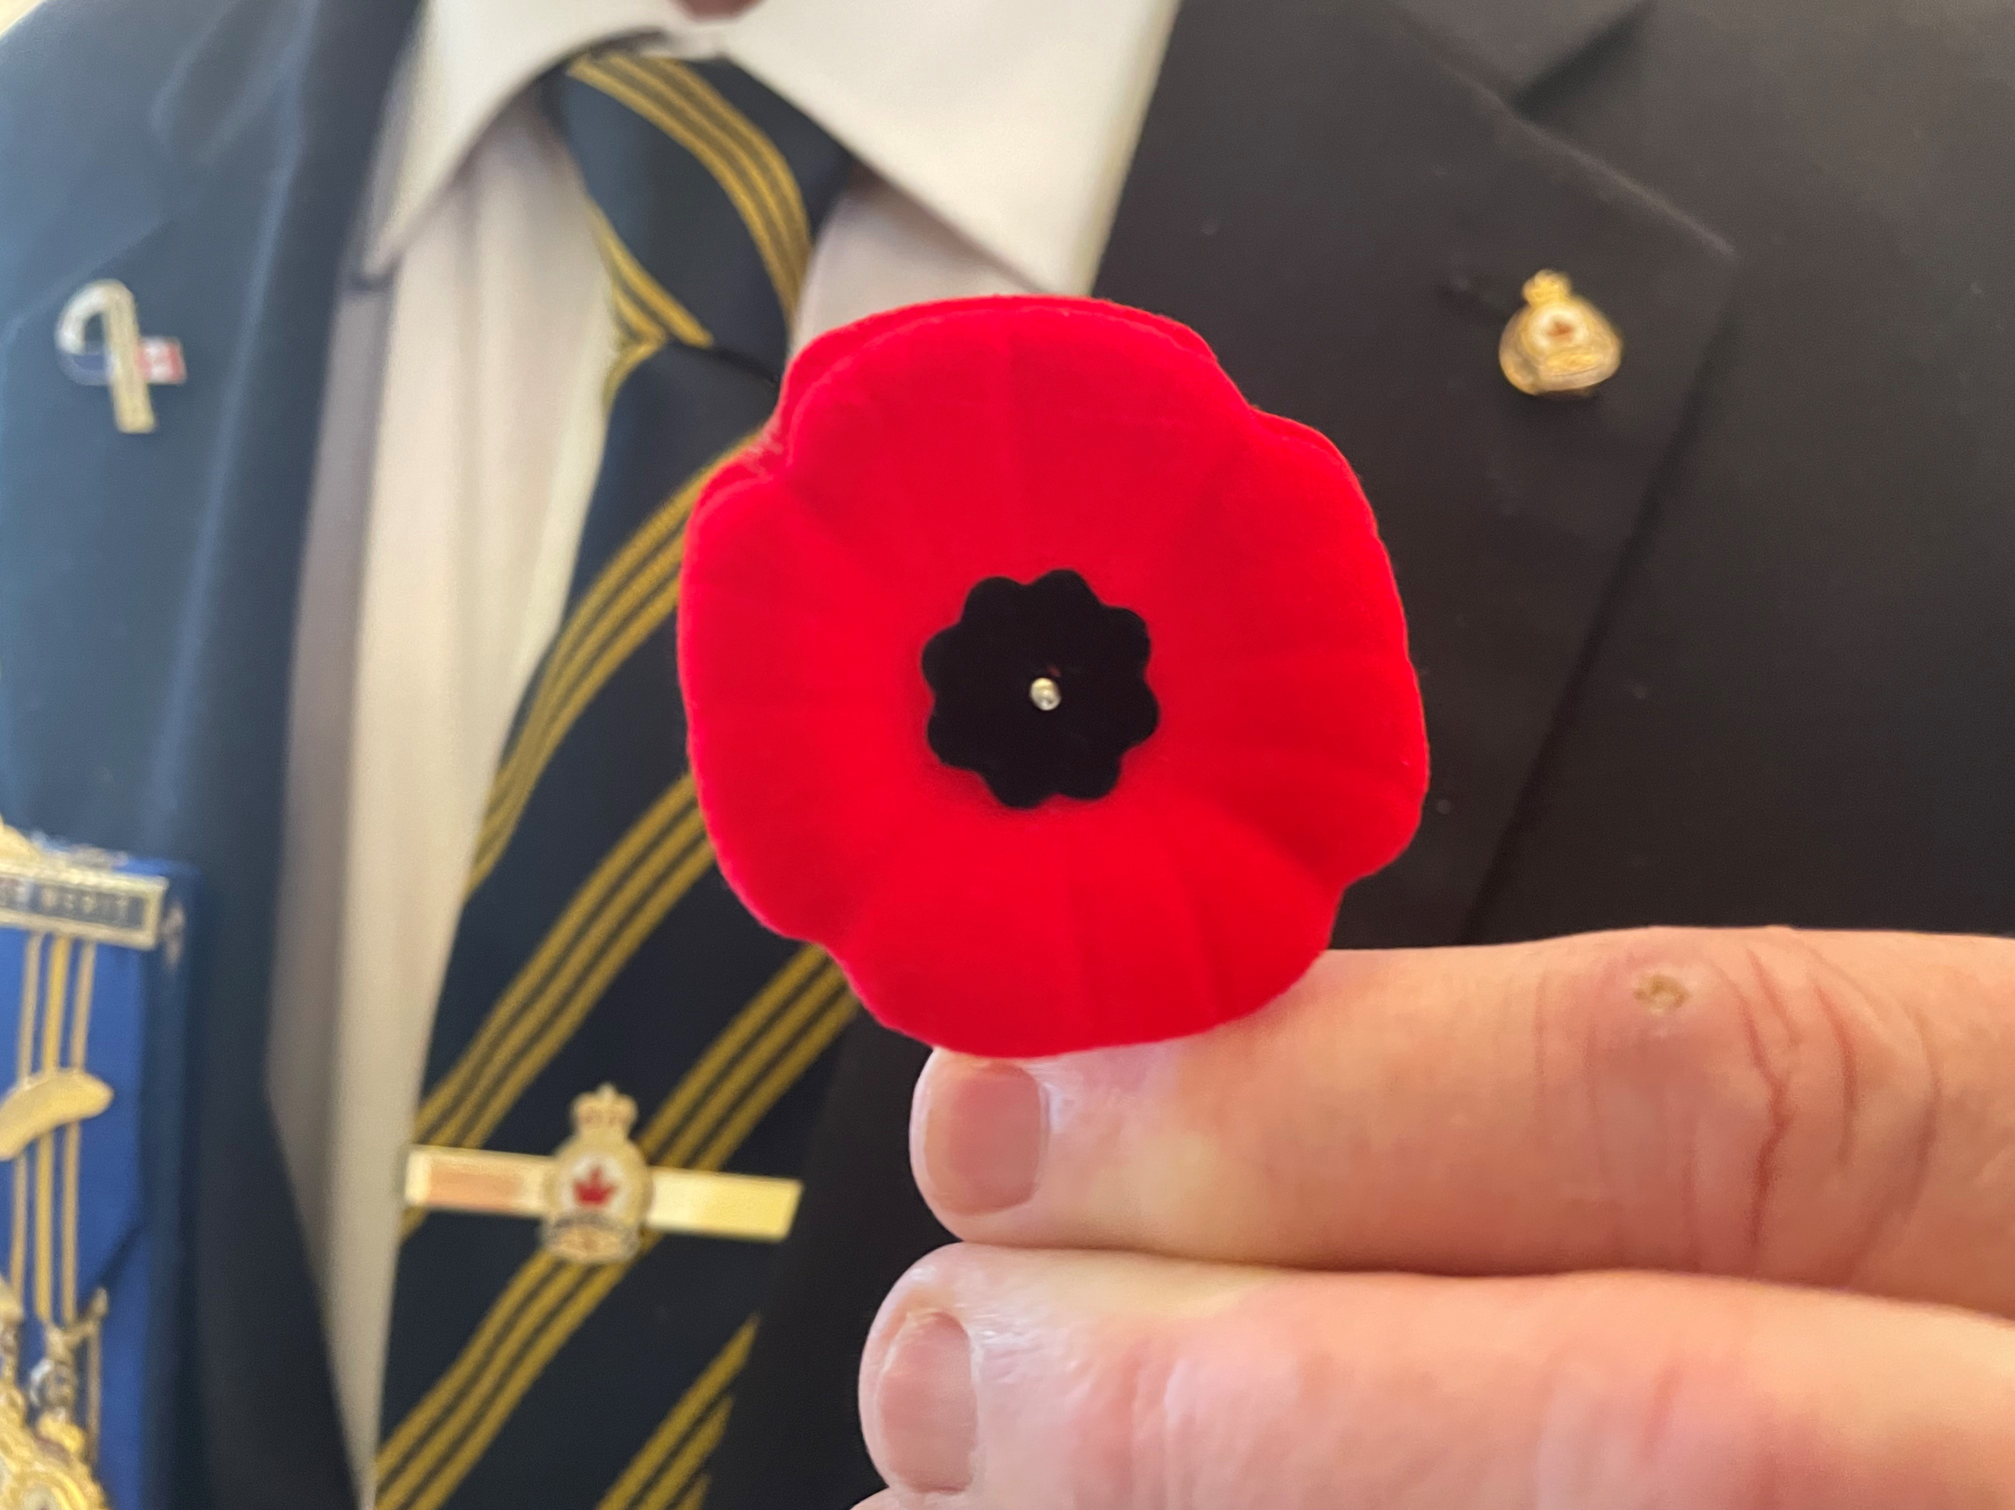
OVERVIEW
The Red Poppy
Canada’s official symbol of Remembrance
Became biodegradable in 2022
Legion responsibility to safeguard as a sacred symbol via Act of Parliament
The Royal Canadian Legion granted Poppy trademark in 1948
Symbol’s use for Remembrance can be granted only by the Legion’s National Headquarters
Notes:
We’re all very familiar with the red Poppy as a symbol of Remembrance.
We celebrated its 100th year in 2021. And it became biodegradable in 2022.
It was first immortalized as part of Lt. John McCrae’s poem “In Flanders Fields.”
The Legion was given the responsibility to safeguard the Poppy as a sacred symbol of Remembrance through an Act of Parliament.
The Legion was granted the trademark of the Poppy symbol in Canada. This trademark was registered in 1948.
As the largest Veterans organization in the country, we were given the responsibility of preserving the Poppy as the symbol of the sacrifice of our Veterans.
This was to ensure that it would never be used for commercial or personal gain or would never be desecrated through inappropriate use.
Only the Legion can grant the use of this symbol in the context of Remembrance (via National Headquarters)

Slide 7
OVERVIEW
Our pillars
Serving Veterans and their families
Promoting Remembrance
Serving our communities
Notes:
The Legion has 3 main pillars or focus areas.
We serve our Veterans and their families…
We promote Remembrance throughout the year, nationally and locally…. (Picture: In 2023 we developed a public relations program to encourage people to take 2 minutes of silence no matter where they are on Remembrance Day)
And we serve our communities in a variety of ways…

Slide 8
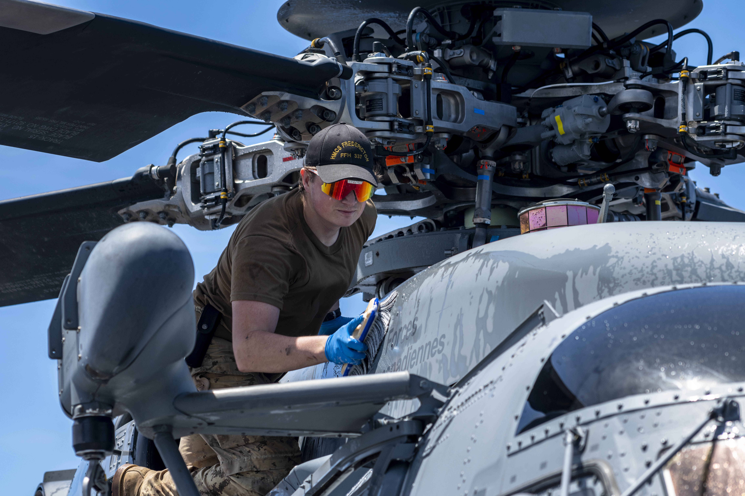
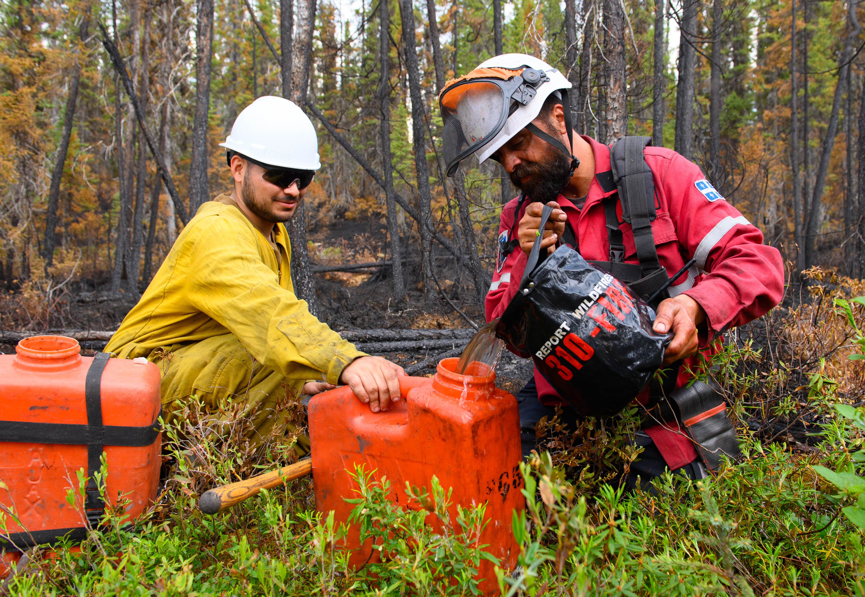
OVERVIEW
Serving Veterans and their families
Veterans Services
Homelessness, Advocacy, Peer support
CAF Operation Santa Claus, Operation Canada Day
Bursaries
The Ladies Auxiliary
Veteran photos: Government of Canada
Notes:
Serving our Veterans and their families includes a lot of things that we’re very proud of…here are some examples…
Our Veterans Services department operates at a national, provincial and Branch level. We have hundreds of Service Officers spread across the country, who are ready to help guide Veterans who might need financial help or help filling out forms to receive benefits from Veterans Affairs Canada. We take all that stress away. These services don’t cost anything and the Veteran doesn’t have to be a Legion member to receive them.
The Legion’s Leave the Streets Behind program includes emergency financial support and helps homeless or near homeless Veterans get off the streets and into a home of their own.
We advocate on behalf of Veterans by speaking with media, and by approaching government and other partners to propose ideas and changes. A couple of topics include tackling the backlog of applications at Veterans Affairs Canada, and ensuring our still-serving Veterans have the tools they need to do their jobs well.
We also support programs such as Peer support initiatives like Buddy Check Coffee and Op Vet Build.
In July and December, we fill bags of goodies for troops overseas through the Canadian Armed Forces’ Operation Santa Claus and Operation Canada Day.
We provide educational bursaries for family members of Veterans.
The Ladies Auxiliary was originally formed by the wives of Veterans, and they remain an important part of many Legion branches and continue to organize support services and special events in communities across this country.

Slide 9
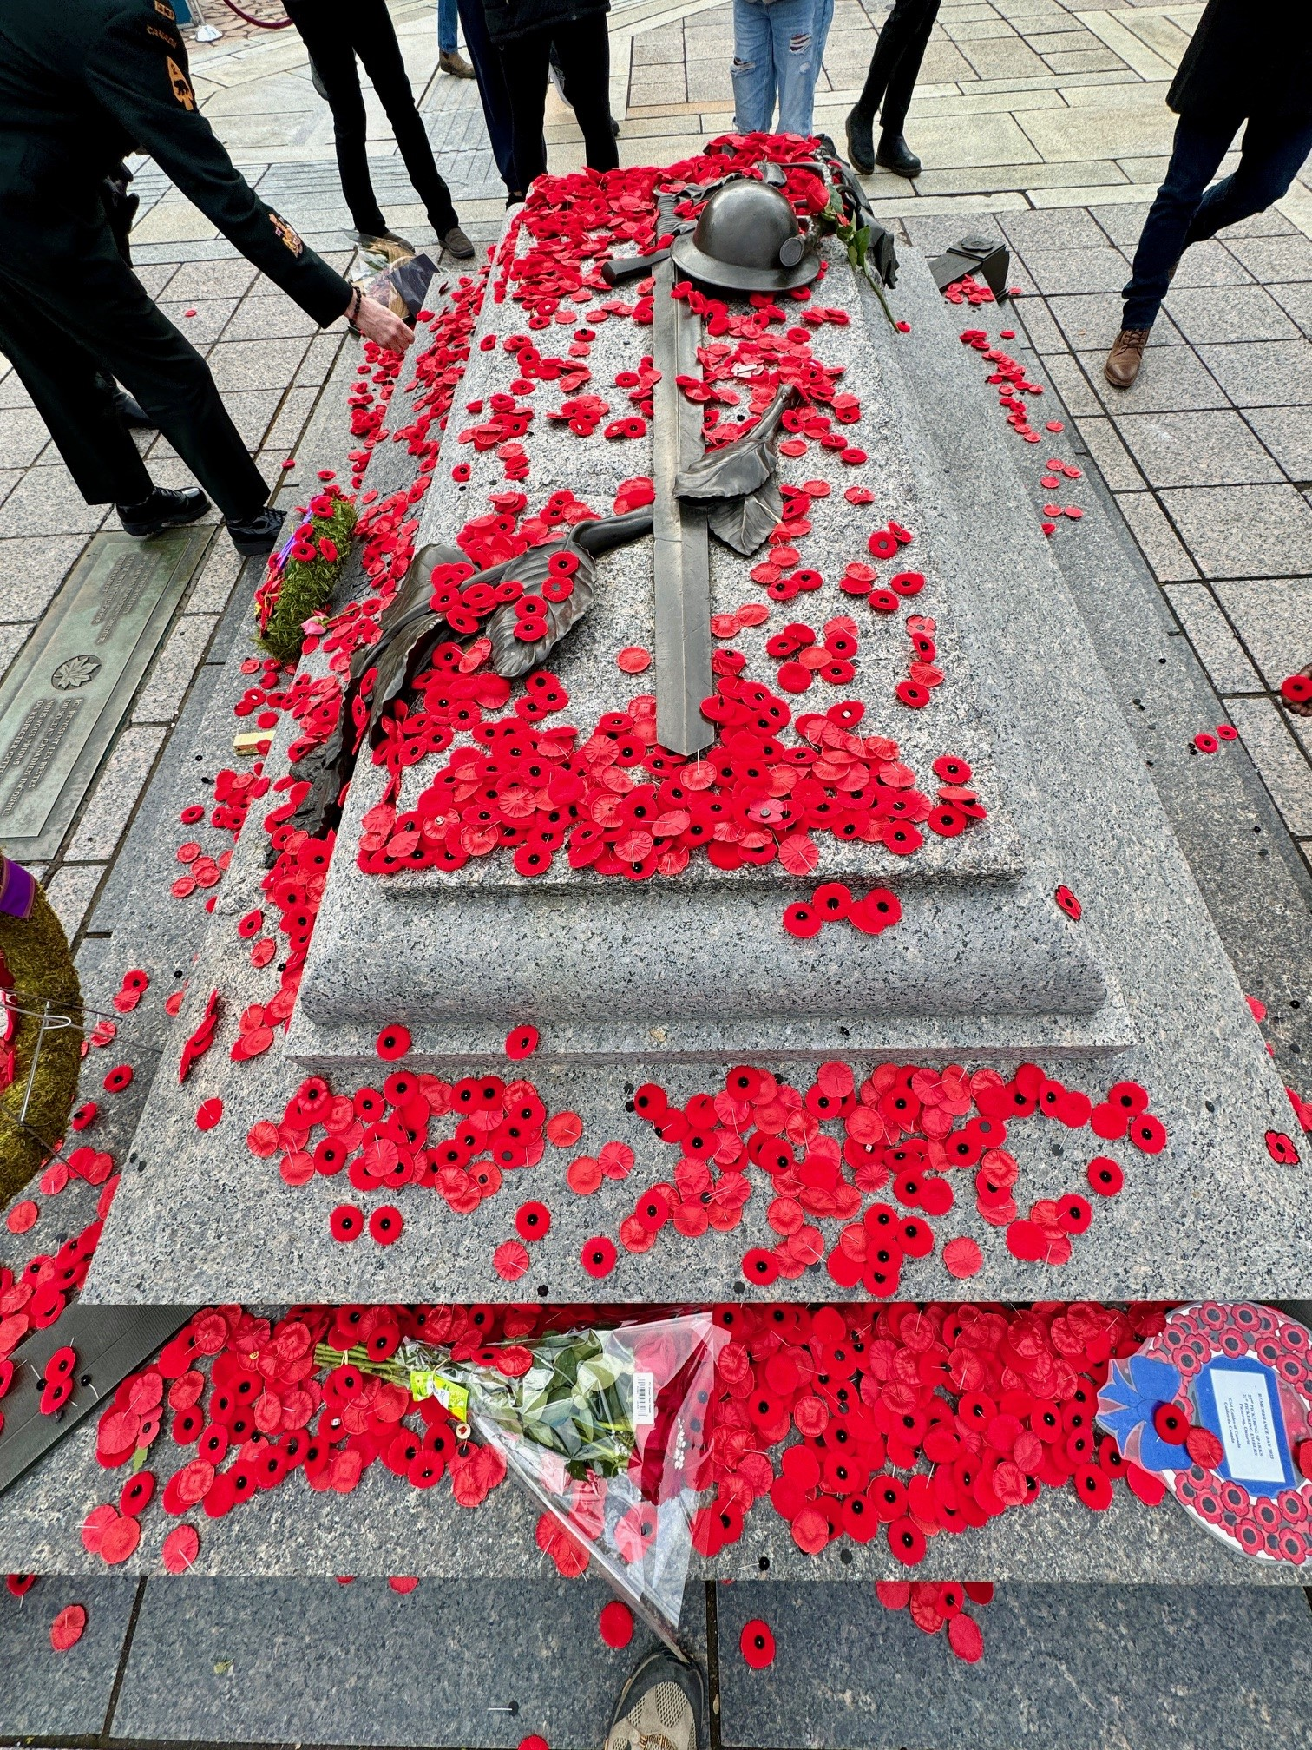
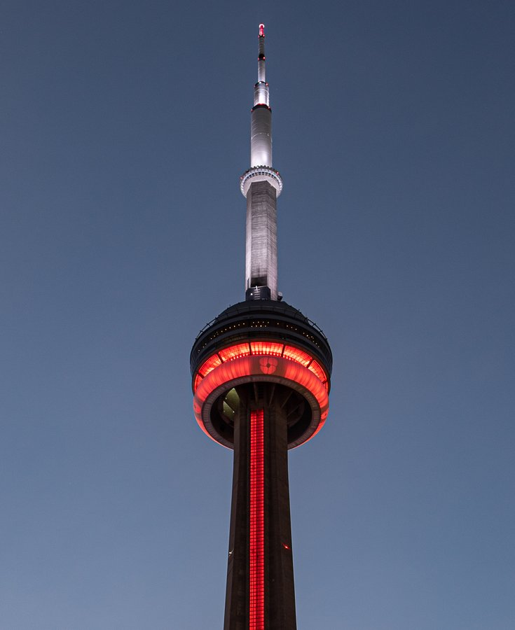
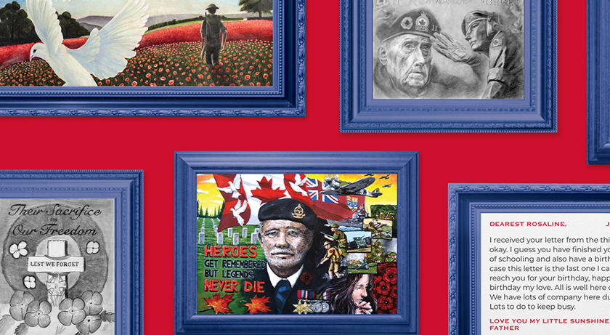
OVERVIEW
Remembrance
National Poppy Campaign
Remembrance Day Ceremonies: local events and national ceremony at National War Memorial (Ottawa)
Poppy Drop & Virtual Wall of Honour on Parliament Hill/ Senate Building, Landmarks (photo courtesy CN Tower)
Poppy Stories Initiative
Youth Remembrance contests www.remembrancecontests.ca
Notes:
We organize and participate in many Remembrance-related activities throughout the year.
Through our National Poppy Campaign starting the last Friday in October, we receive millions of dollars in donations from generous Canadians. These Poppy Trust Funds go back into the community to help Veterans, their families and our communities. We have several ways to donate including traditional and tap to donate boxes, plus online at Legion.ca.
We organize and oversee the National Remembrance Day Ceremony at the National War memorial in Ottawa. We select the National Silver Cross Mother from nominations made by Canadians, and on November 11, she places a wreath on behalf of all mothers and families who have lost a child in the service to their country. Our local Branches hold many ceremonies as well.
As part of the Remembrance period, we also showcase a Poppy Drop on Parliament Hill, and on the Senate building - with virtual poppies falling on the Centre Block at night, and it is broadcast on Facebook live for all to see. Canadians send us pictures of Veterans, and they are also displayed on a Virtual Wall of Honour on the Hill.
Canadian landmarks light up to commemorate as well - places like the CN Tower and BC Place Stadium in Vancouver.
During the campaign, we run our Poppy Stories initiative. People can go to poppystories.ca to scan their lapel poppy and read the story of a Canadian Veteran – last year, we highlighted peacekeepers.
Each year, we also help promote Remembrance through our annual national youth remembrance contest. The Legion National Foundation - with the support of The Royal Canadian Legion and schools across the country - invites our youth to honour our Veterans through artwork, writing, and video.

Slide 10
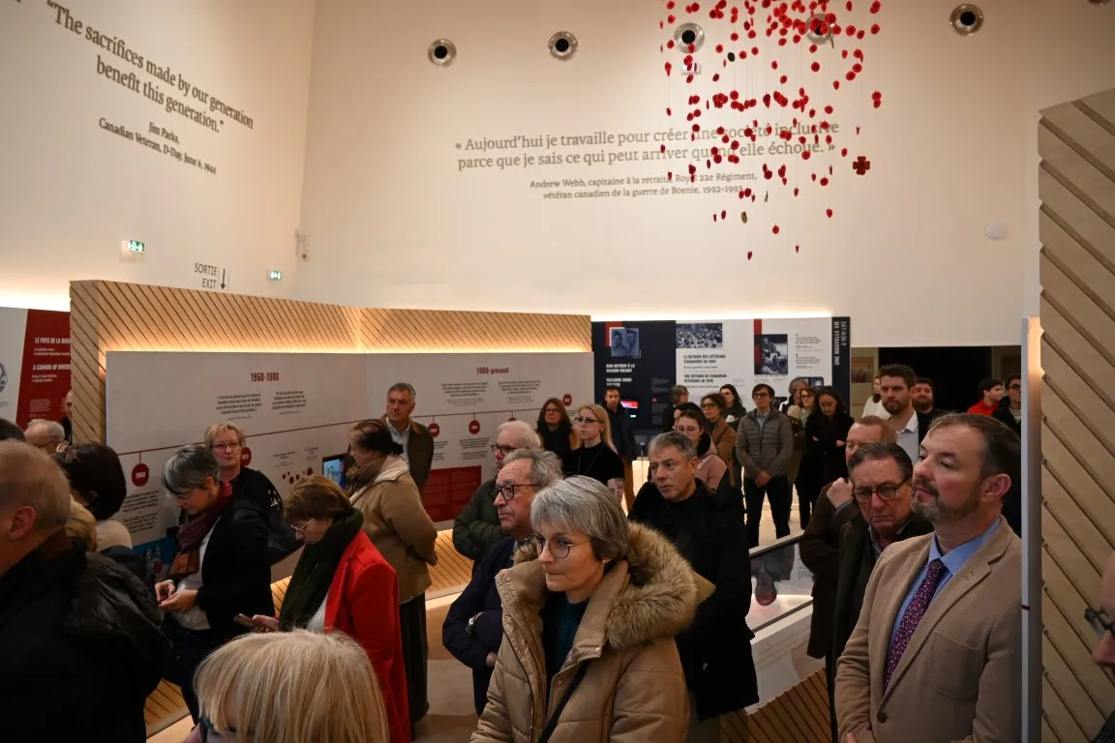
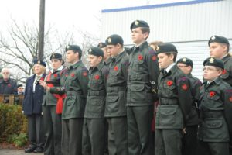
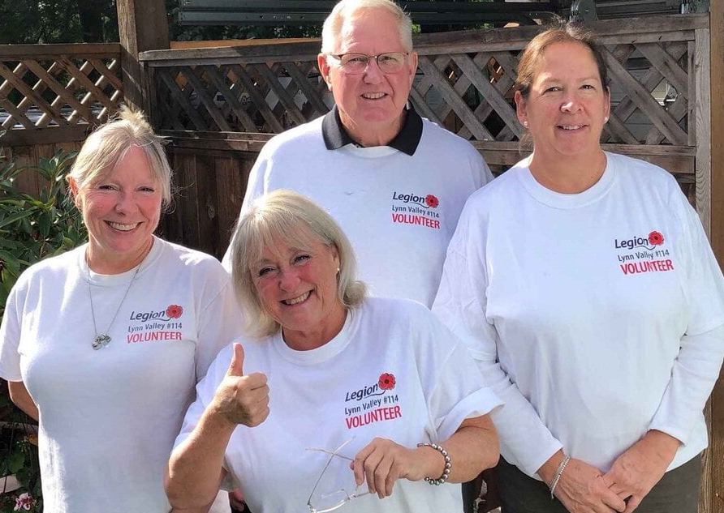
OVERVIEW
Serving Communities
Donating to organizations that serve or remember our Veterans
Support for local/community organizations
Assisting Cadet corps (Air, Army, Sea, Jr. Rangers)
Fostering friendship and camaraderie at Branches with theme nights and events
Providing branch space for community meetings
Notes:
Every year, our Branches complete an amazing amount of work – mostly with the help of volunteers…
At the local and national levels, we make significant donations to organizations that provide services accessed by our Veterans or projects that promote remembrance. For example, we provided $100,000 to the Juno Beach Centre for a project to honour and remember the contribution of our ethnically diverse society during times of conflict and peace; and we gave close to $100,000 to help fund work on a national project by the University of Alberta to support and enhance resilience in families of Veterans.
Locally, using their general funds, our branches also support community projects, charities and other groups not related to Veterans.
We sponsor and support hundreds of Cadet corps units across the country, including Air, Army, Sea, and the Junior Rangers.
Our Branches are often the hub of their community, with special theme nights, events and dinners, and are regularly used for community meetings.

Slide 11
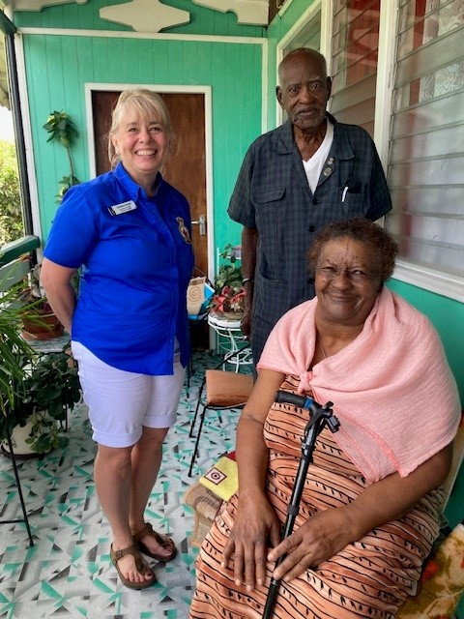
OVERVIEW
Our footprint
Close to $20 million donated during National Poppy Campaign to help Veterans, families and communities.
NHQ Veterans Services dept. assisted over 3,300 Veterans with benefits-related applications (2023)
Advocacy & media efforts e.g. ending the VAC benefits application backlog; encouraging 2 minutes of silence
Helped over 60 Veterans and spouses in Caribbean with two meals a day; provided Poppy materials and office equipment to branches (2023)
Notes:
I’d like to share a short overview of the sorts of things we are able to accomplish at the Legion thanks to the support of our members, and individual and corporate donors.
As part of our National Poppy Campaign, close to 20 million dollars are donated each year and close to that same amount goes back into our communities to support Veterans, families and communities.
In 2023 for example, our national Veterans Services department assisted over 3,300 Veterans with benefits-related applications. Many more Veterans were helped at a local level.
We take on a range of advocacy issues each year. Things like pushing for an end to the benefits application backlog at Veterans Affairs Canada, and asking for operational changes in the Canadian Forces in the wake of reported military sexual trauma cases. We promote Remembrance yearly, such as with the 2023 PR campaign to take 2 minutes of silence on Remembrance Day, no matter where you are.
Each year, we help around 60 Veterans and their spouses living in over a dozen Caribbean countries, through the Royal Commonwealth Ex-Services League. These Commonwealth Veterans include Canadians. (Also Veterans and spouses from Great Britain, Australia, New Zealand, South Africa). The goal is to provide each with at least two hot meals per day. We also help Branches such as providing Poppies or helping with office needs. (Photo: This is a colleague with a widow in St. Lucia. In this instance, the UK provided the funding to beneficiaries and the Legion provided poppy materials to help manage their poppy campaign and raise funds to help their Veterans.)

Slide 12
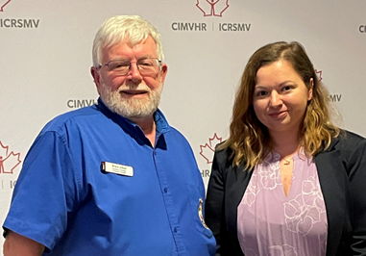
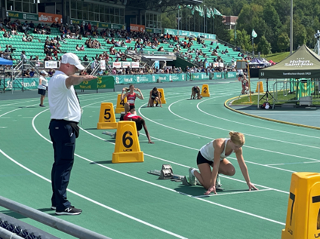
OVERVIEW
Our footprint
$30,000 Masters scholarship awarded; new $50,000 PhD. scholarship announced
Legion Nationals Youth Track and Field Championships: Sherbrooke, QC (2023)
National member sports championships
Thousands of care packages created as part of the CAF’s Operation Santa Claus and Operation Canada Day (2023)
Notes:
We provide a 30-thousand-dollar master’s scholarship to a university student annually – the newest project is being undertaken by Kathryn Reeves of Mount St. Vincent University is focused on moral injury in Veterans. In 2023 we announced the creating of a new $50,000 PhD. Scholarship that will be awarded to a student studying a health topic focused on Veteran well-being.
We support Canada’s youth - including through a national Track and Field championship called the Legion Nationals. The most recent version was held in 2023 in Sherbrooke QC, with hundreds of athletes meeting for friendly competition, learning about Remembrance, and coming away with new leadership skills and friends. Many competitors are supported by Legion branches and commands.
Branches also hold local leagues for darts, eight-ball and cribbage – and the Legion holds local and national competitions in these games.
Each year, we create thousands of care packages that are sent to our soldiers serving overseas. This is part of the Canadian Armed Forces’ Operation Santa Claus and Operation Canada Day projects.

Slide 13
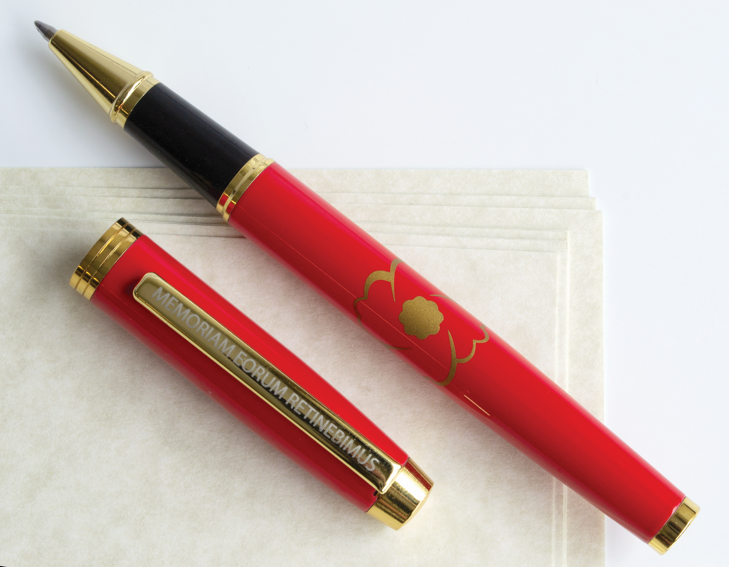
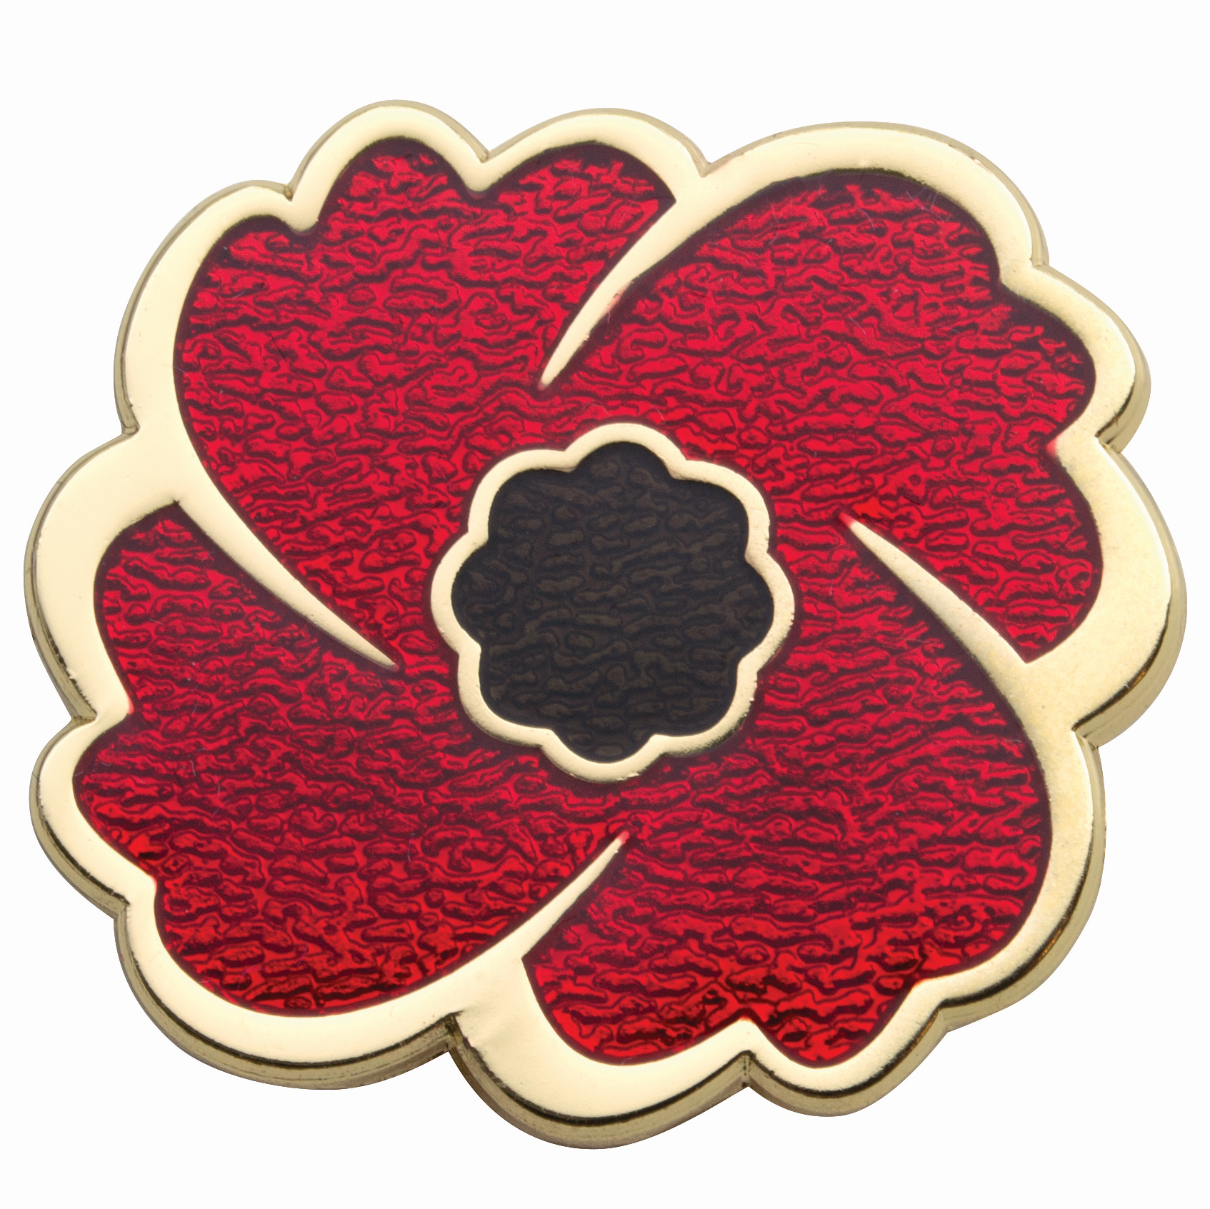
OVERVIEW
Operational updates
New membership: 43,000 new and reinstated members in 2023
Expanded online portal; digital membership cards, more benefits
Released new Poppy Store items in support of Legion operations
Thousands of members used MemberPerks program – since 2020 debut, over 2 million dollars saved
Notes:
When it comes to operations…we’ve seen some great growth in membership over the past 2 years, with 43,000 new and reinstated members joining in 2023 alone.
Even more members renewed their membership with our revamped Membership portal which allows people to sign up online. We now have downloadable digital membership cards and more member benefits have been added.
Going forward, the Legion remains focused on attracting new members – like some of you - and remaining relevant to Veterans and the community, while modernizing what we offer.
In 2023 we released several new Poppy Store items which help people visually remember our Veterans. Support for our store helps us with all our operations to support our Veterans.
We’ve also continued to see growth in the number of people signing up for our MemberPerks program and since it debuted in 2020, members have saved over 2 million dollars on items provided by outside vendors.

Slide 14
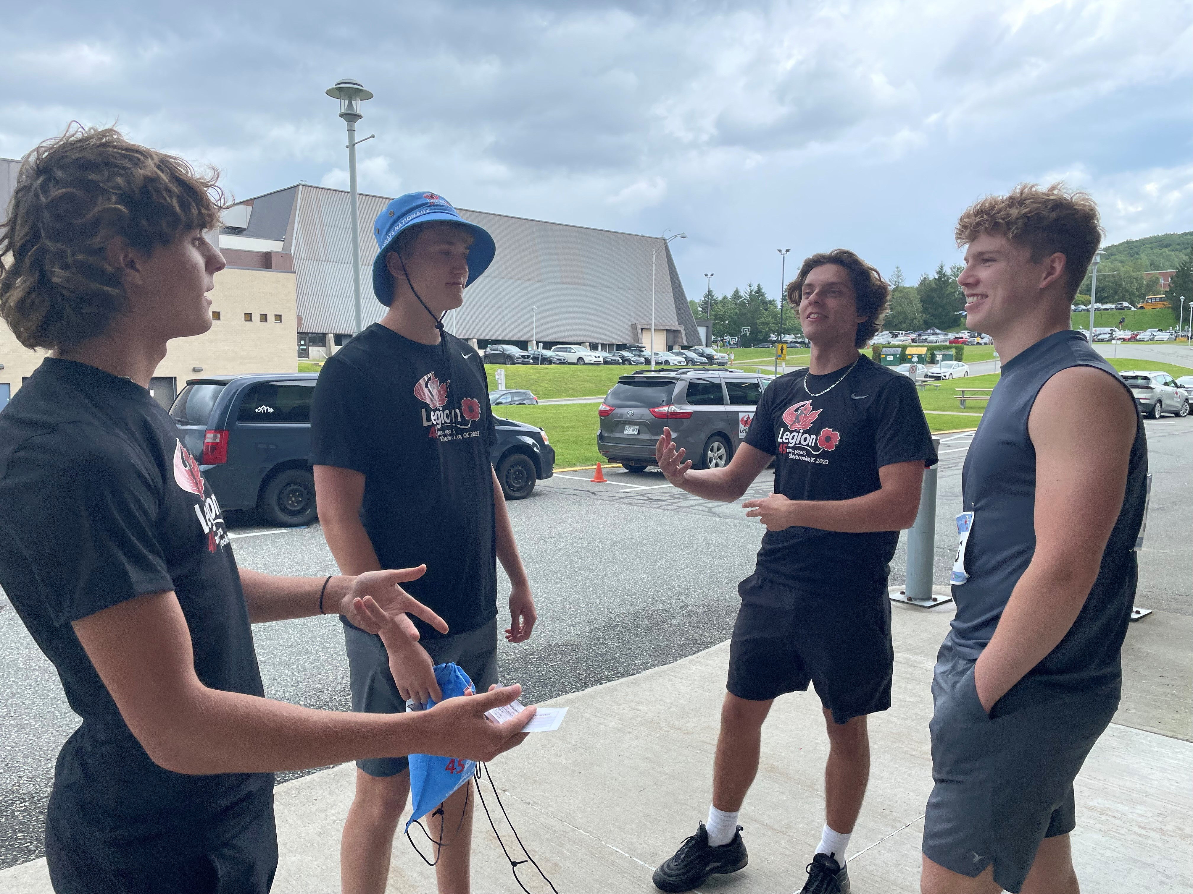
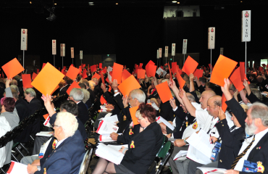
OVERVIEW
Operational updates
Veteran Feedback:
“My life has settled…I would not be in this position had it not been for (local service officer) and Canadians supporting the Legion’s Poppy Campaign”
In 2024/2025:
Legion Nationals event – Calgary Alberta
Dominion Convention – Saint John, NB
2025 Royal Commonwealth Ex-Services League conference - Ottawa
Notes:
We’re proud to hear the feedback we receive each year from Veterans we’ve been able to help. This quote is from one person who was assisted by a local service officer and shared how their life has stabilized thanks to the Legion and to those who support our National Poppy Campaign.
A bit about what’s next…in 2024 we’ll hold our next Legion Nationals Track and Field event in Calgary, Alberta.
Our next national Dominion Convention will be in Saint John, New Brunswick, and we’re busy planning for that too. At these meetings, we review operations and members can put forward and vote upon resolutions if they are proposing some sort of change.
And in 2025 we will help host the Royal Commonwealth Ex-Services League conference in Ottawa. This international League helps assist Commonwealth Veterans.

Slide 15
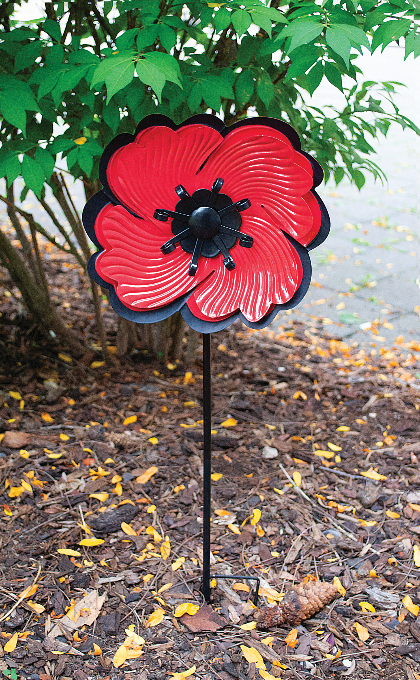
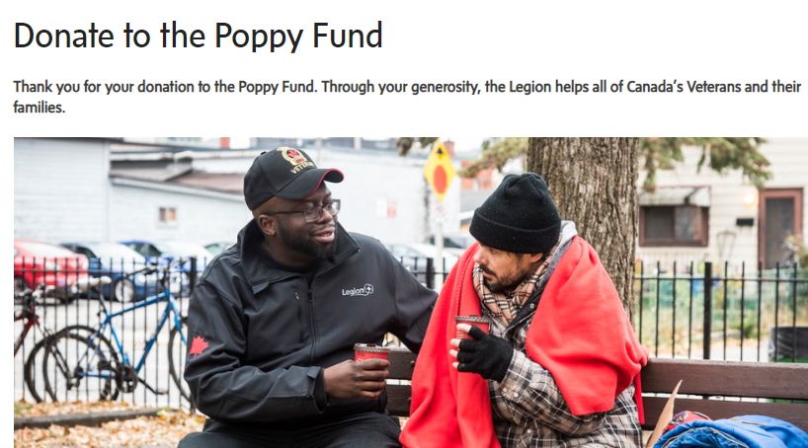
OVERVIEW
Other ways to support
The Poppy Store
www.Poppystore.ca
Donating online
www.legion.ca
Notes:
Finally, a quick note that while our National Poppy Campaign in November is very familiar to Canadians, some of you may not be aware of other ways to help support the Legion.
I mentioned our Poppy Store earlier… it is located online at poppystore.ca – there, you will find many interesting Remembrance items including pins, clothing and household items. Each time you purchase an item, the funds raised help us operate so we can support our Veterans.
The Legion also has an online donation portal through which you are welcome to support our work.
Thank you for listening!

Slide 16
Thank you
Legion.ca
©THE ROYAL CANADIAN LEGION
Notes:
I’m happy to take any questions.
If I can’t answer your question today, I (or another colleague) will get back to you with the information as soon as possible.
And if you aren’t already one, we invite you to become a member either by joining online or visiting your local Legion branch. You can find all you need to know at Legion.ca

