Slide 1

Honouring Veterans is our duty
Legion.ca
04/07/2018
©THE ROYAL CANADIAN LEGION

Slide 2
Membership:
What’s New.

Slide 3
What’s New:
Membership Website
Maximizing the New Technology
Member Online Renewals – New Payment Options
New Membership Cards / 2019 Renewal Stickers
Welcoming New Members
Email Communications

Slide 4
Membership Website – Year #1:
85%
Branch Participation
20,000
Registered Members
130,000
Members Processed
200,000
Option for Online Renewal

Slide 5
Website Feature Review:
Members cannot join your local branch online
Members can only renew for a local branch online
Real time reporting – branch specific
Access to Branch Membership records

Slide 6
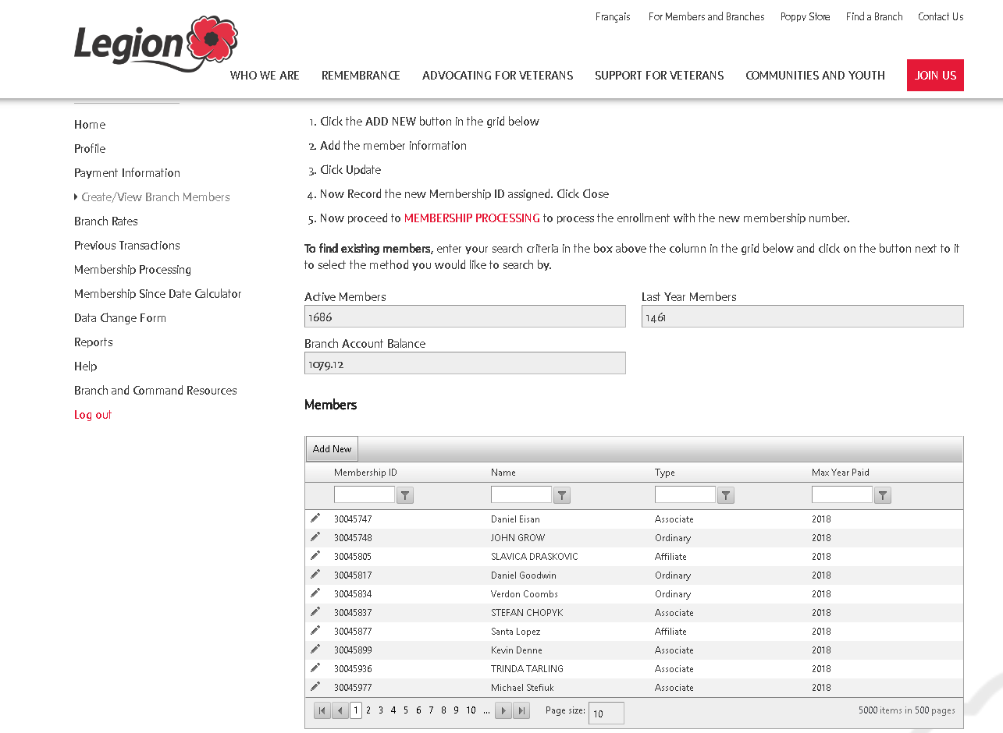

Slide 7
New Membership Features:
Online member renewals
Annual auto renewal from members
Automatic branch notification when member completes online renewal

Slide 8
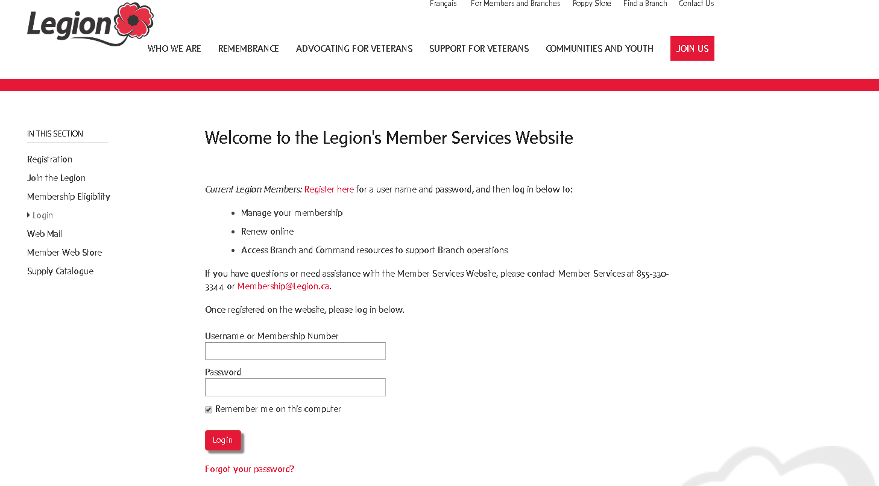
Accessing Your Branch Web Mail

Slide 9
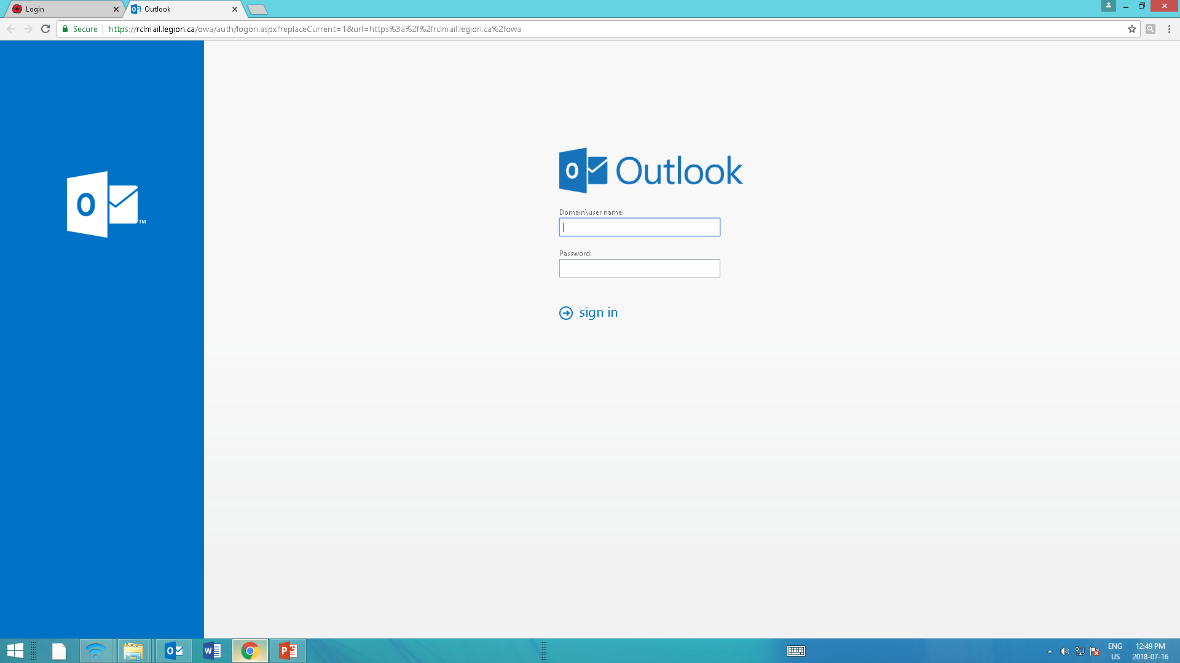
Accessing Your Branch Web mail

Slide 10
Maximizing the Technology - Branches:
Access up-to-date branch reports and member status
Process members online to eliminate paperwork
Membership Website – Branch Processing Guide, step by step instructions on using the membership website – Download the Guide
Complete Data Change Information online

Slide 11
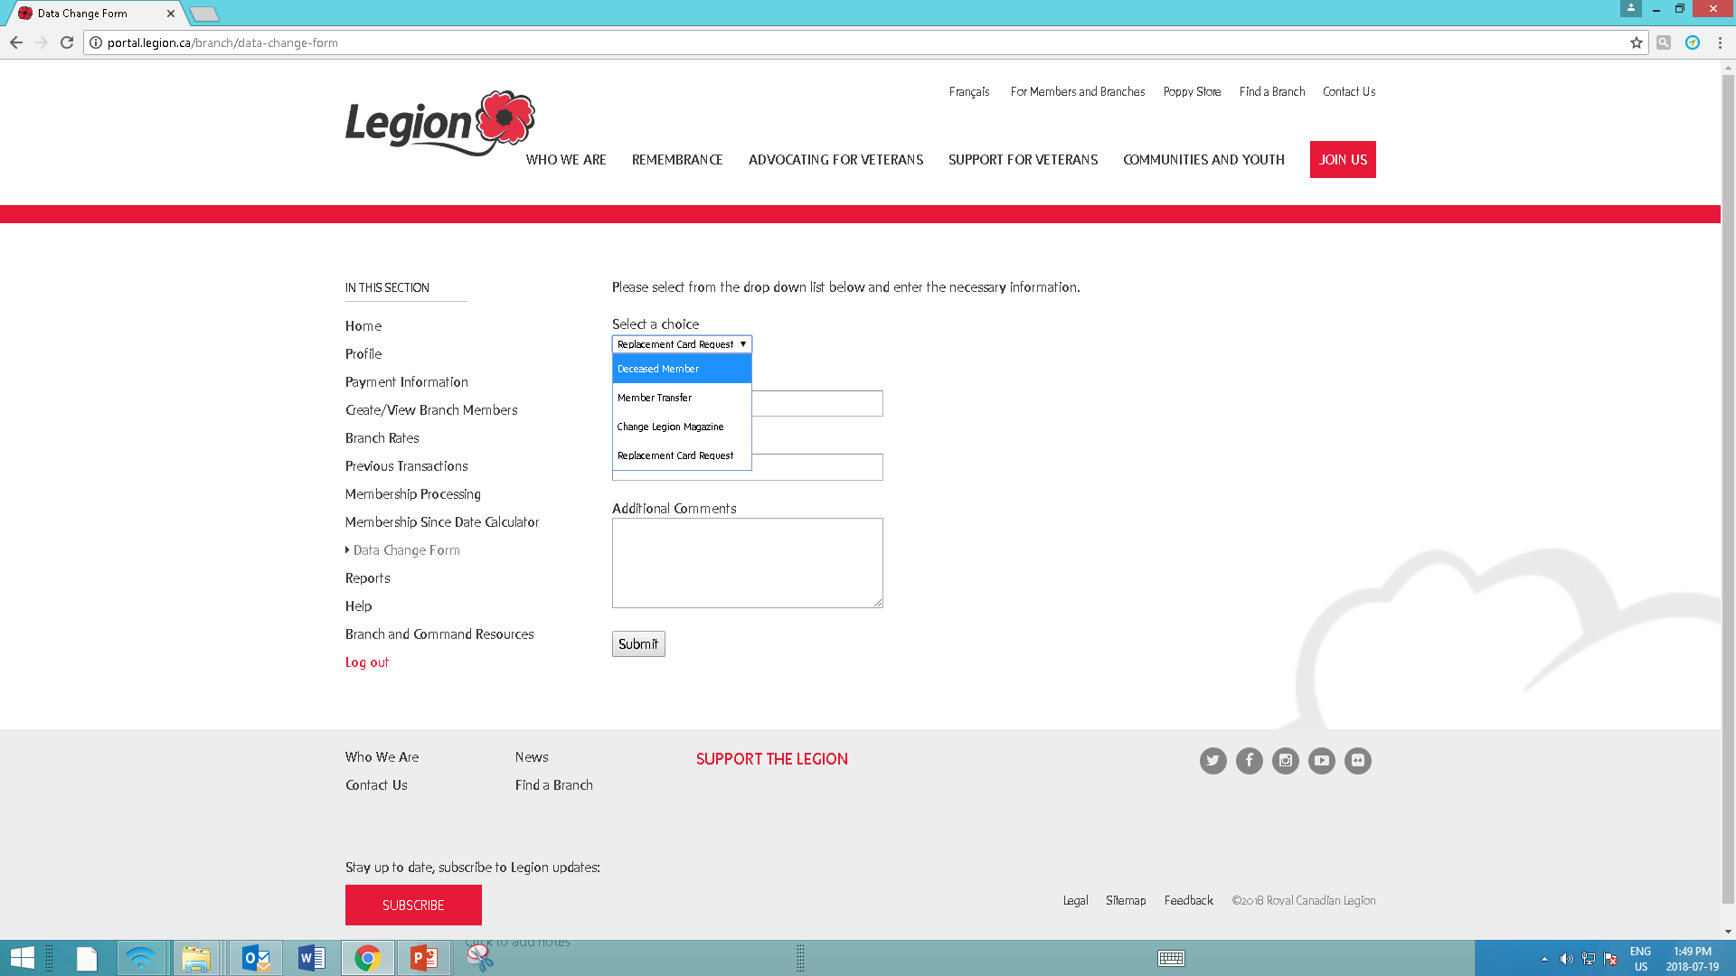

Slide 12
Maximizing the Technology - Members:
Enter and update member contact information
Encourage members to register online
Educate members regarding online renewals and annual auto renew option

Slide 13
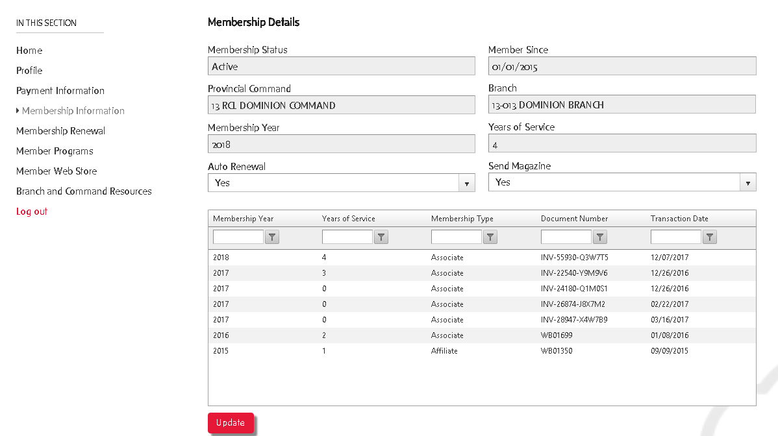

Slide 14
Online Member Renewals:
Step #1 – Ensure your branch membership fees are entered
Step #2 – The member must register their membership

Slide 15
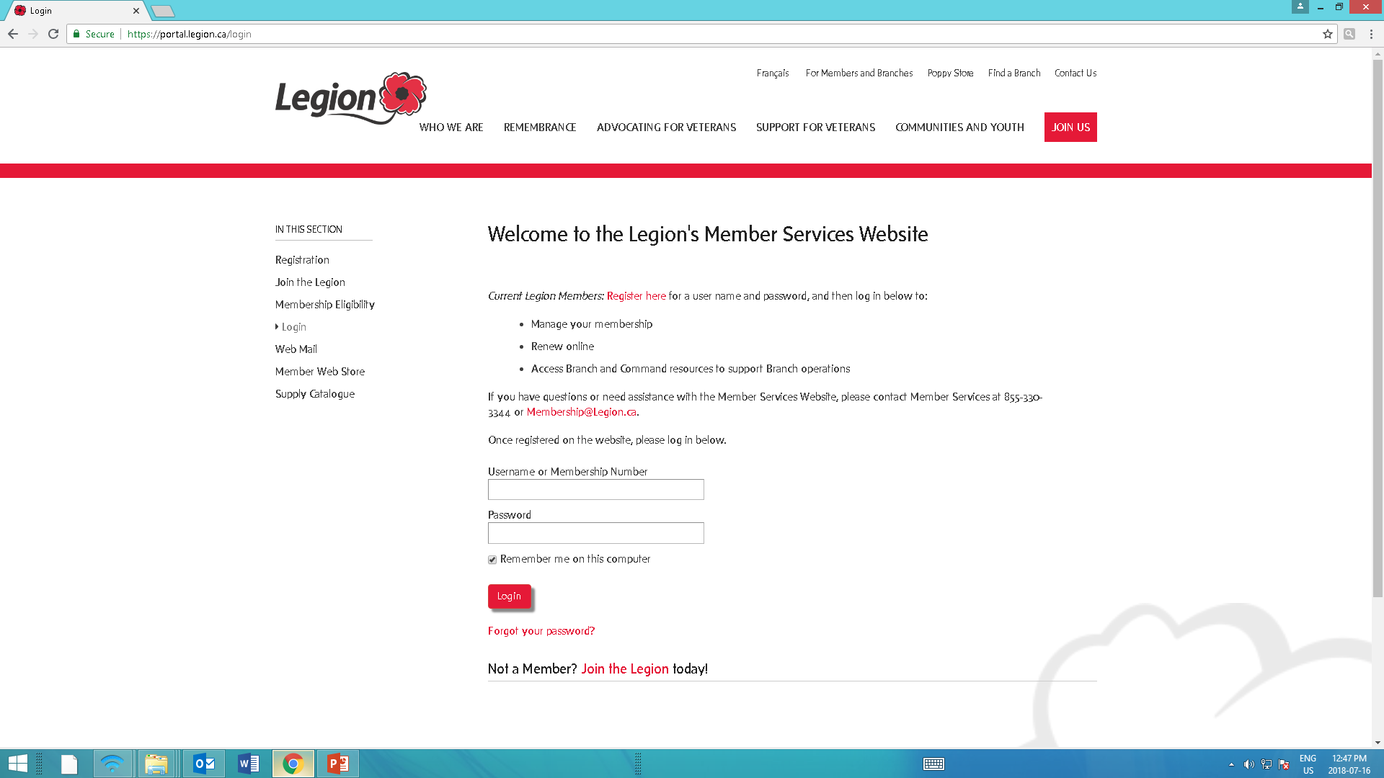

Slide 16
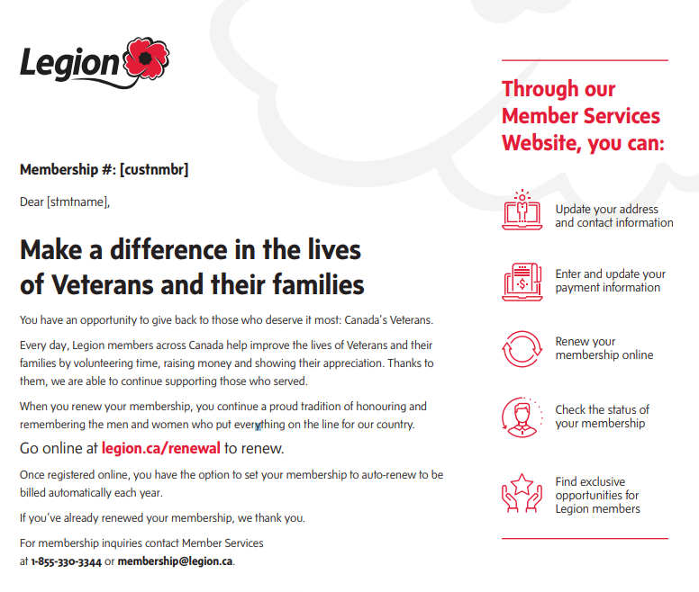
Email Renewal Reminders

Slide 17
When member makes online payment:
  1. Branch receives email notification
  2. No paperwork is required
  3. Membership card or renewal sticker will be sent to the branch
  4. Once a month a cheque and report is sent to the branch for their portion of the member renewal

Slide 18
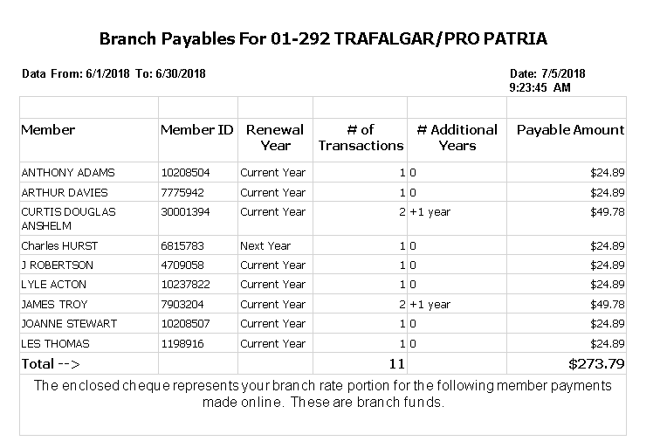

Slide 19
Online Member Renewals cont’d:
Branch rates will be automatically copied from year to year – branch only needs to update if fees change
What if all your members renewed online?

Slide 20

New Membership Cards:

Slide 21

New Membership Cards
Plastic cards will last for minimum of 5 years
Annual Stickers will be issued each year

Slide 22
2019 Renewal Stickers
Will be delivered to your branch the last week of August…. via Canada Post
You will receive a 2019 sticker for all members who were paid for 2018 by July 31, 2018.
For any members who renewed after July 31 for 2018 and 2019 you will be sent a 2019 sticker once processed by Member Services.
All cards and renewal stickers continue to be delivered to branch

Slide 23


Slide 24

Life Members

Slide 25
Welcoming New Members
The Membership Committee worked closely with the Ritual and Awards Committee to streamline the sign up process for new members
The objective:
  1. Accelerate the sign up process for new members
  2. Assist in eliminating potential barriers to new members joining the Legion
The formal Initiation Ceremony is now called a Welcoming Ceremony and is an optional process to membership in The Royal Canadian Legion
If the Branch chooses to retain the ceremony, the guidelines can be found in the Ritual, Awards Protocol Manual

Slide 26

Welcoming Email:

Slide 27
Email Communications
  Regular Communications:
  1. Legion Dispatch Newsletter
  2. Member updates
  Sent to:
  1. Your local branch email address on branch profile page
  2. Your standardized @legion.ca address
  Who receives? Who reads?

Slide 28
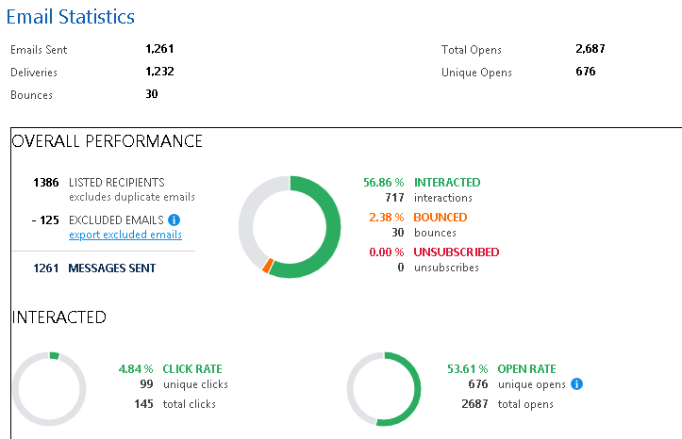
Email Communications
we

Slide 29
3 Takeaways:
Ensure your branch membership fee is entered in membership website
Encourage your members to register and/or enter their email address in membership website
Check your branch emails regularly

Slide 30
Member Services
Membership@legion.ca
1-855-330-3344

