Slide 1

THE POPPY
Danny Martin – Secretary to Poppy & Remembrance
Legion.ca
04/07/2018
©THE ROYAL CANADIAN LEGION

Slide 2

The Poppy
GENERAL
THE POPPY TRADEMARK
THE POPPY FUND
THE POPPY CENTRE
THE DIGITAL POPPY
THE BELLS OF PEACE

Slide 3

GENERAL INFORMATION ON THE POPPY

Slide 4
AUTHORITY
THE DOMINION EXECUTIVE COUNCIL, BETWEEN MEETINGS OF THE DOMINION CONVENTION, SHALL EXERCISE ANY OF THE POWERS CONFERRED ON THE DOMINION CONVENTION (GBL 409.A) INCLUDING ALL POLICIES AND DIRECTION IN REGARD TO THE POPPY TRADEMARK, POPPY CAMPAIGN AND POPPY FUND.
THE POPPY MANUAL IS THE GOVERNING DOCUMENT APPROVED BY CONVENTION. NO OTHER GOVERNING DOCUMENT EXISTS.
THE RESPONSIBILITY FOR ALL POPPY AND REMEMBRANCE MATTERS AND ACTIVITIES IS VESTED IN THE NATIONAL POPPY AND REMEMBRANCE COMMITTEE WHICH INCLUDES OVERSEEING AND ENFORCING THE RULES AND REGULATIONS OUTLINED IN THE POPPY MANUAL.
EACH PROVINCIAL COMMAND HAS A POPPY AND REMEMBRANCE COMMITTEE WHICH FOLLOWS THE DIRECTION OF THE POPPY MANUAL AND THE NATIONAL POPPY AND REMEMBRANCE COMMITTEE.

Slide 5
BRANCHES FOLLOW THE DIRECTION OF THE POPPY MANUAL. IF AN INTERPRETATION IS NEEDED OR THERE IS AN AREA NOT COVERED BY THE POPPY MANUAL YOU MUST CONSULT WITH YOUR PROVINCIAL COMMAND. YOU CANNOT INTERPRET THE MANUAL OR VEER FROM THE DIRECTION IT PROVIDES WITHOUT CONSULTING YOUR COMMAND.
TO PROCEED WITHOUT AUTHORITY THROUGH CONSULTATION CAN RESULT IN AN EXTRODINARY AMOUNT OF PAPERWORK, LEGAL QUAGMIRES, AND A LOSS OF FACE AND GOODWILL WITHIN YOUR COMMUNITY AND IN SOME CASES NATIONALLY.
TO AVOID THESE PITFALLS ASK QUESTIONS FIRST. THE OLD ADAGE OF ITS EASIER TO PROCEED AND ASK QUESTIONS LATER DOES NOT WORK WHEN IT COMES TO MATTERS CONCERNING THE POPPY MANUAL.
  READ AND CONSULT THE POPPY MANUAL.
  ASK QUESTIONS TO YOUR PROVINCIAL COMMAND
  ASK QUESTIONS TO DOMINION COMMAND T: 613-591-3335 EXT 249
  TOLL FREE: 1-888-556-6222 EXT 249

Slide 6
THE POPPY TRADEMARK

Slide 7
The Poppy symbol is a registered trademark of Dominion Command of The Royal Canadian Legion and is owned and controlled by Dominion Command. It cannot be used in any manner or configuration without the specific permission of Dominion Command.
THIS IS THE REGISTERED TRADEMARK

Slide 8

What is required to request use of the Poppy:
Contact information for the individual or organization making the request.
A description of how and where the Poppy will be used or displayed (attach a draft design of image placement or size, if applicable)
An explanation of why the Poppy usage is requested
An indication of what period of time the Poppy will be used or displayed
A disclosure, if intended for use on a product, of the selling cost of the item and a projection of the expected profit to be made
An indication of where the profit, if any, will be directed, whether to an organization, charity or manufacturer

Slide 9
WHAT DOES THE TRADEMARK MEAN?
IN CANADA NO SYMBOL THAT RESEMBLES THE POPPY THAT IS BEING USED IN THE CONTEXT OF REMEMBRANCE OR VETERAN SUPPORT OR USED TO ADVOCATE FOR ANOTHER CAUSE CAN BE USED WITHOUT THE AUTHORITY OF DOMINION COMMAND OF THE ROYAL CANADIAN LEGION.

Slide 10
EXAMPLES OF USE AND ABUSE

Slide 11
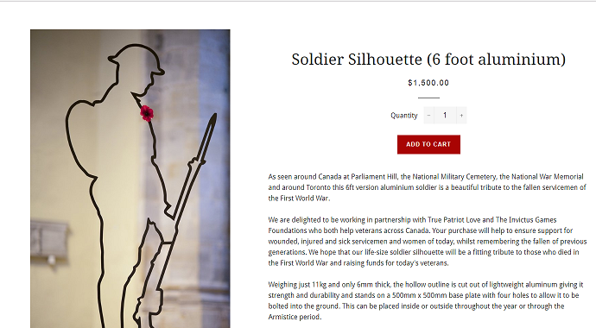

Slide 12


Slide 13
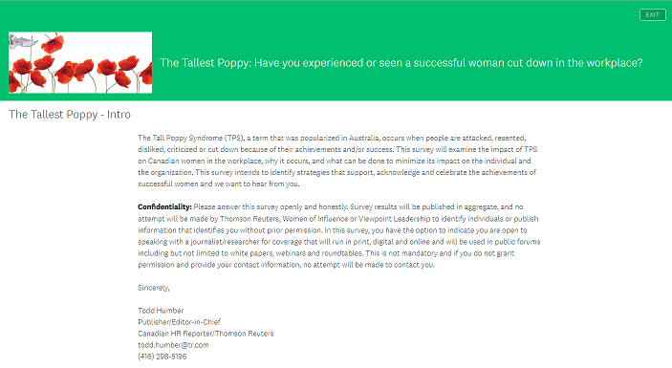

Slide 14
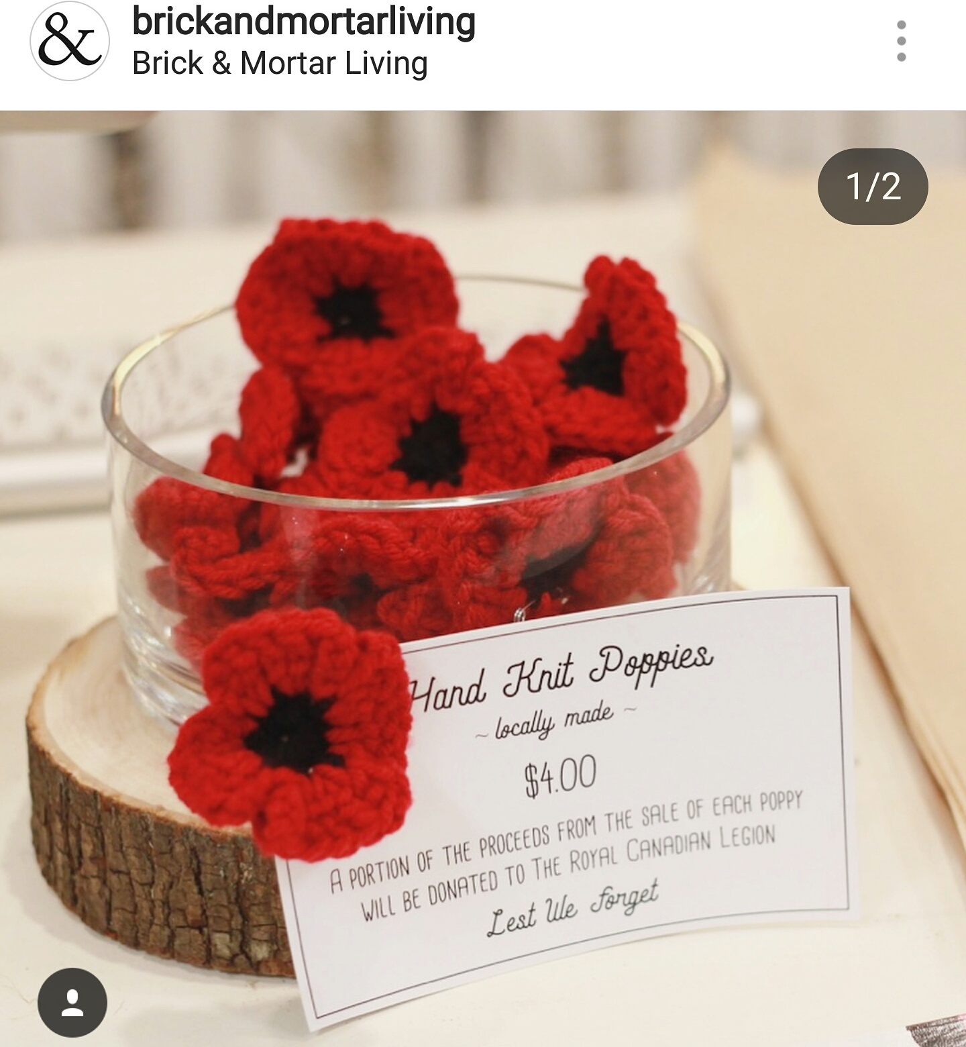

Slide 15
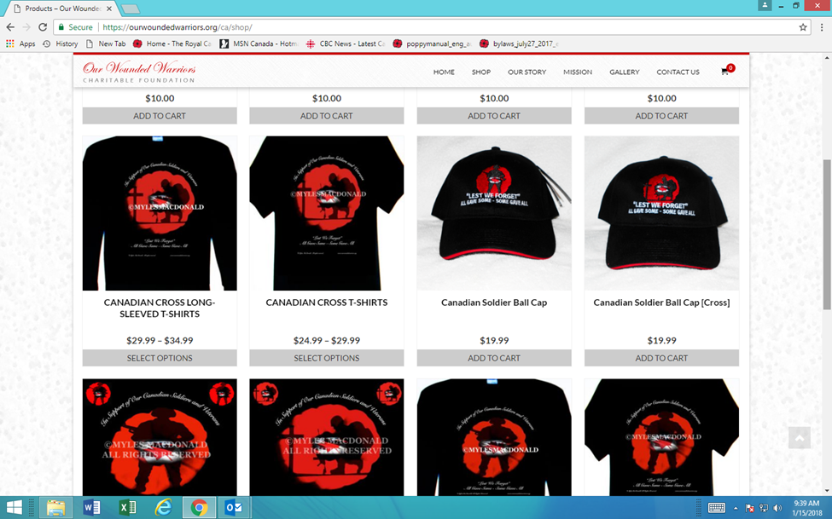

Slide 16
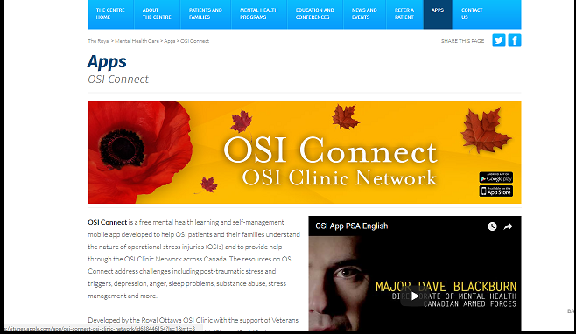

Slide 17
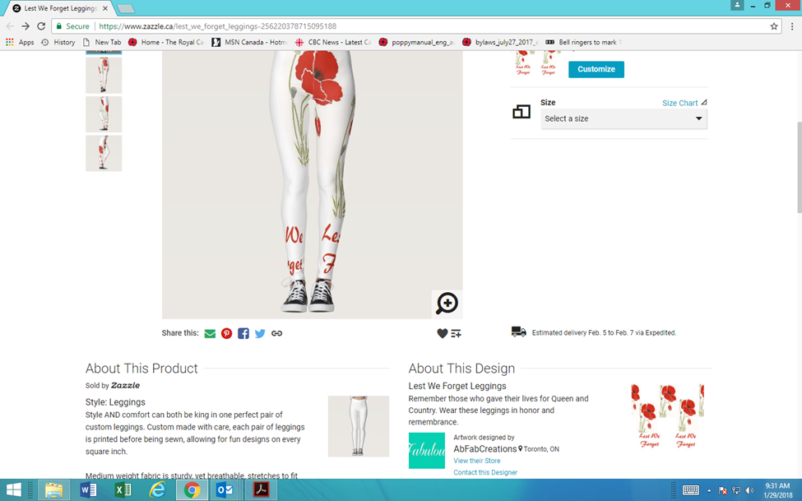

Slide 18
AUTHORIZED USE

Slide 19


Slide 20


Slide 21

This is the Legion logo which contains the Poppy Trademark. It is for branch and command use with your branch or command indicator as depicted below. You are authorized to use. To use without a branch indicator you must get permission from the Director of Supply. This logo is also trademarked.

Slide 22
WITHOUT CONSTANT PROTECTION OF THE POPPY TRADEMARK WE WILL LOSE THE ABILITY TO ENFORCE!
What can you do?
Do not use the poppy trademark without authorization.
Do not give authority (which you do not have) for another organization to use.
Report to your command or to Dominion Command any unauthorized use.

Slide 23
THE POPPY FUND

Slide 24

It is through the Poppy Campaign and the generosity of our fellow citizens that, in addition to providing assistance to Veterans and their families, we foster the Tradition of Remembrance amongst our youth, the leaders of tomorrow.
Poppy Funds are made available through the generosity of the Canadian public and are part of the public trust
Between Canadians and the Legion. To safeguard this bond, Poppy Trust Funds must be held in trust at each Branch and Command level of the Legion. They may not be used as, or in place of, general or any other Branch funds.

Slide 25
GENERAL RULES FOR USE OF POPPY FUNDS
Branches must follow the guidelines outlined in the poppy manual.
If in doubt consult your Provincial Command or Dominion Command.
When you make donations to community organizations ensure you highlight that it is for veterans first and foremost: “the Royal Canadian Legion Branch # for helping us expand our medical services to be sure that veterans, their families and the greater community have access to ???”

Slide 26
Outside organizations seeking funding must be preapproved by your command. It is not usual for one charity to donate to another charity. If it happens they must post on their web page that funding was provided through the Legion Poppy Fund.
National organizations seeking funding across provincial lines must be preapproved by Dominion Command. It’s an accountability issue.
If you want to open up Poppy Funds to other areas you can - BY RESOLUTION TO CONVENTION.

Slide 27
Once a year Canadians give generously to the Poppy Fund with the impression that they are helping veterans and their families. In order to keep faith with those that donate it is our solemn responsibility to follow the guidelines of the Poppy Manual.

Slide 28
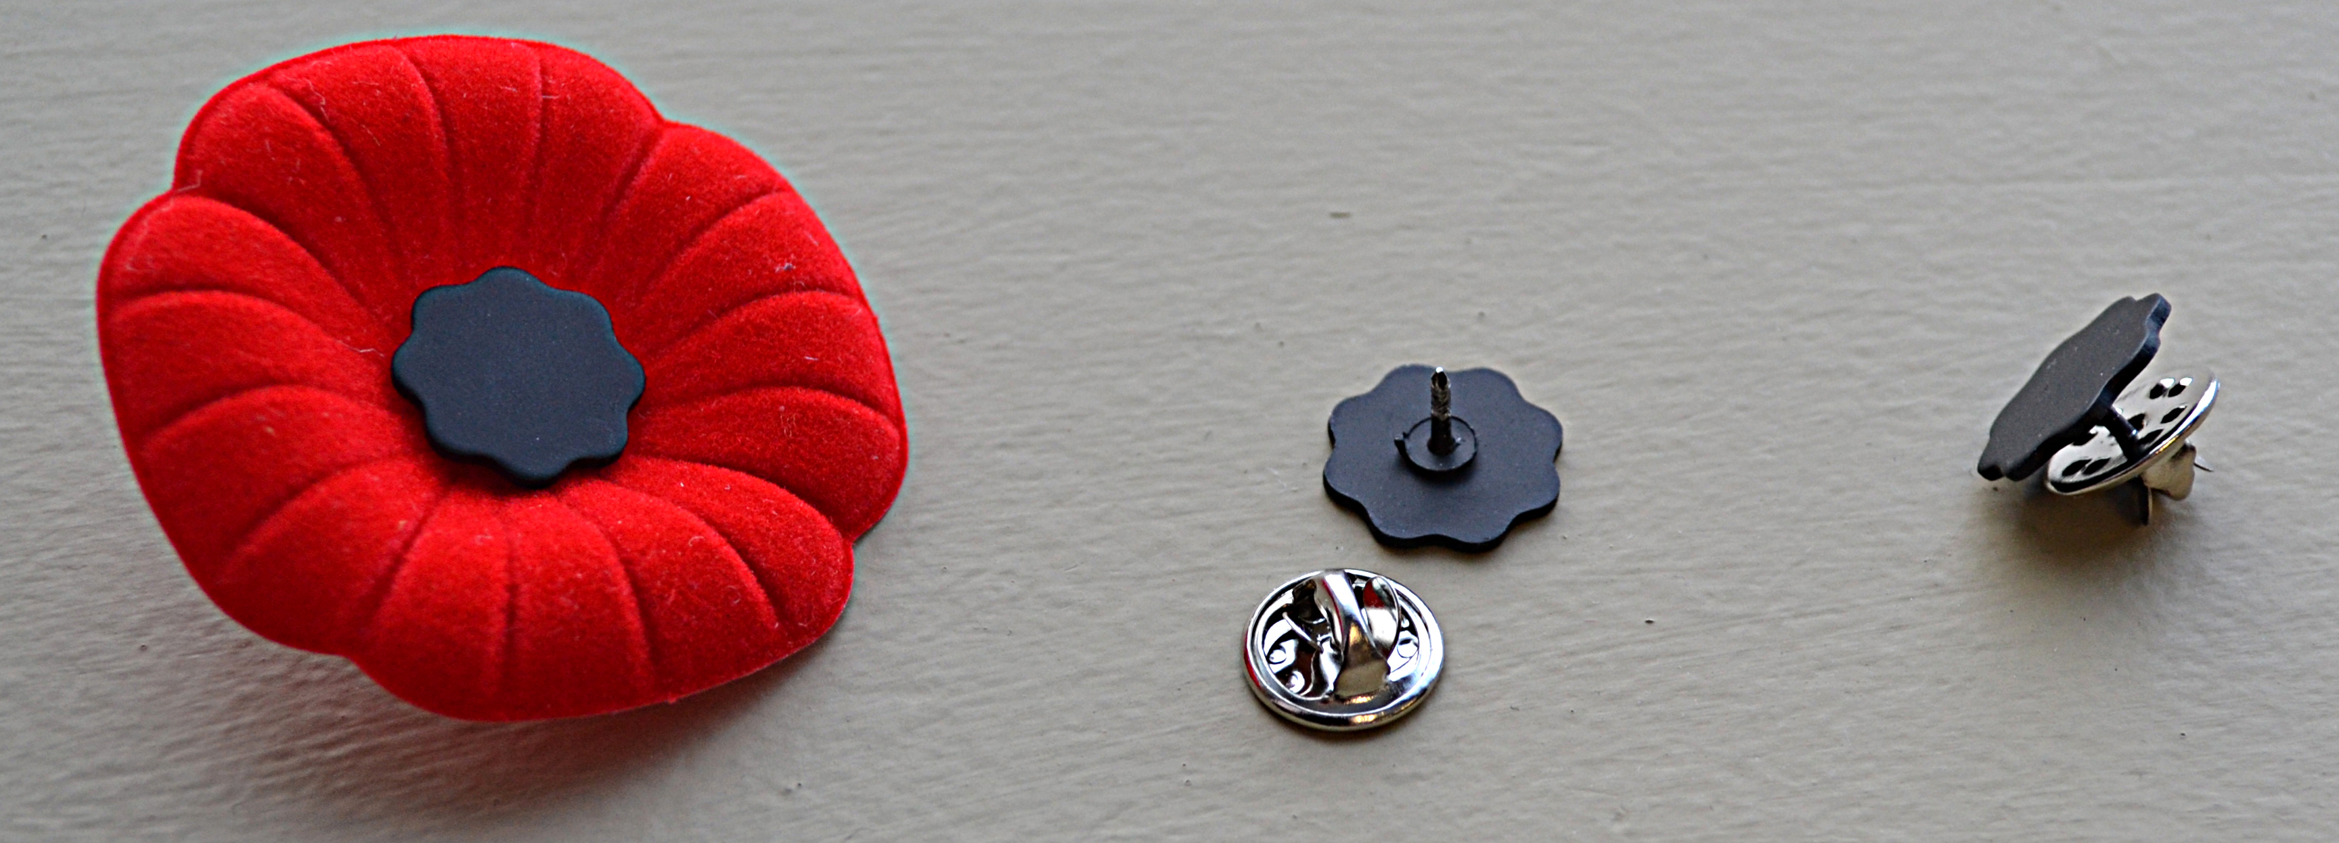
THE POPPY BUTTERFLY PIN

Slide 29

Why?
There is a demand.
Schools are banning the traditional poppy.
Other organizations are producing pins for either personal gain or other charities.
People are using other pins to secure the poppy.

Slide 30
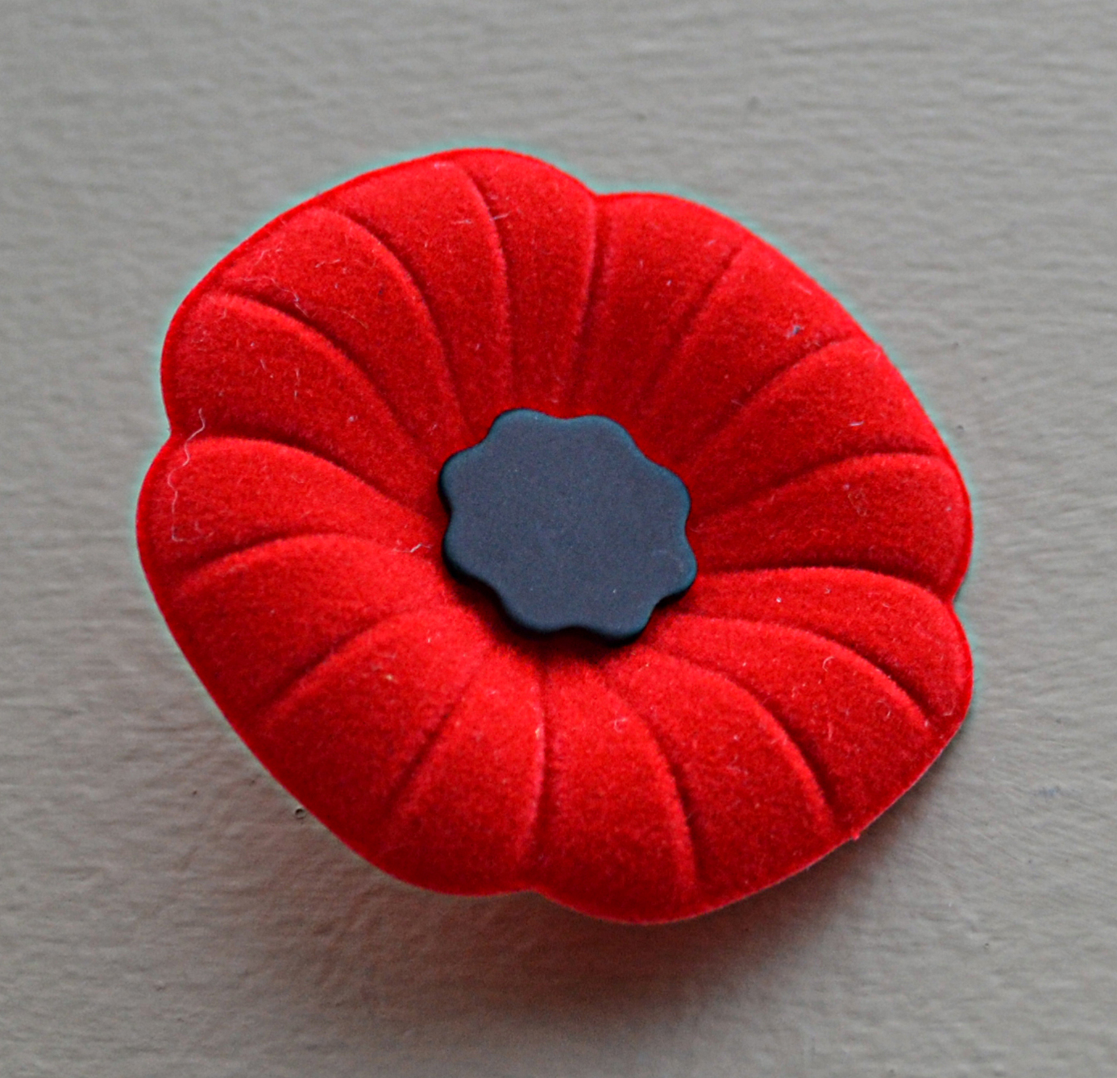
Available from Dominion Command Supply.
Not a donation item – should be a set price.
Remember Poppies are not sold but rather distributed

Slide 31
THE DIGITAL POPPY

Slide 32
THE ROYAL CANADIAN LEGION 2018 DIGITAL POPPY CAMPAIGN
The digital poppy campaign supports & expands the Legion’s lapel poppy program
The two-sided digital poppy features the donor’s name & the veteran being remembered
Digital poppies are posted as donors’ profile images & displayed on all social media sites

Slide 33
Digital poppy donations are made via MyPoppy.ca
Donations are made via credit card & all orders are immediately fulfilled
Digital poppy funds are distributed to Legion branches via postal code sorting

Slide 34
The digital campaign runs at the same time as the regular campaign – i.e. last Friday in October to 11 Nov at midnight
At midnight on 11 Nov all digital poppies are removed.

Slide 35

BELLS OF PEACE – A REMEMBRANCE OF THOSE WHO SERVED IN THE FIRST WORLD WAR

Slide 36

AIM
To create a remembrance event that highlights the sacrifices of Canadians who served in WWI.

Slide 37
COMPONENTS OF PLAN
Engage all communities, the military and churches in this endeavor.
The bell(s) would be tolled 100 times,
Each community/bell would start the ringing at the going down of the sun on 11 Nov as per the sunset timing in their area.

Slide 38

Several communities will be asked to enhance this remembrance activity by highlighting a significant historical event within the context of WWI,
Legion branches should lead the way in the communities where they are located.

Slide 39
As a prelude to this event we would like to see Canadian school children search out those that served in WWI and place a small Canadian flag on that person’s grave.
Share your images or videos online using #100Bells or uploading to the Woobox campaign page.

Slide 40
TIMINGS
Letter sent out to all branches in July 2018
Branch package with instructions by 21 September
Official launch 24 Oct 2018

Slide 41


QUESTIONS
Contact dmartin@legion.ca

